Slide 1
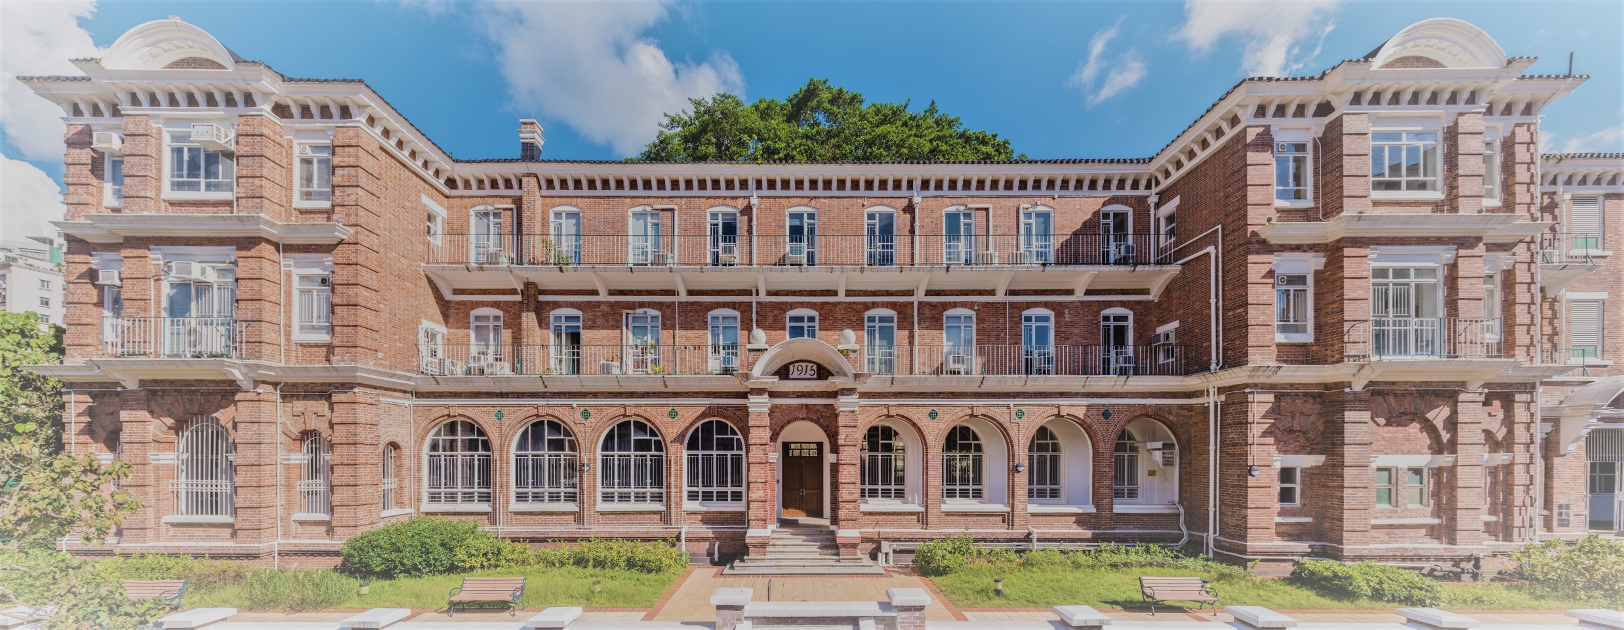
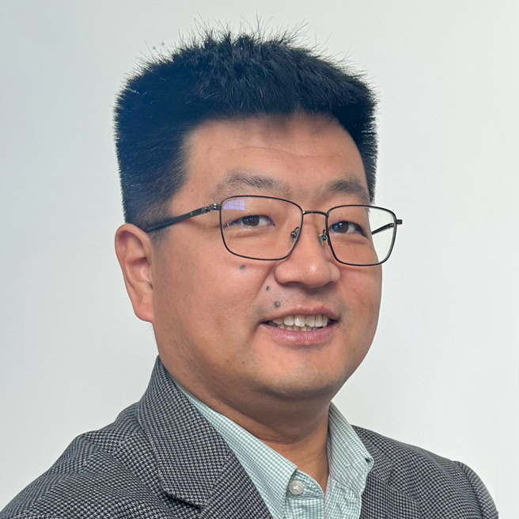
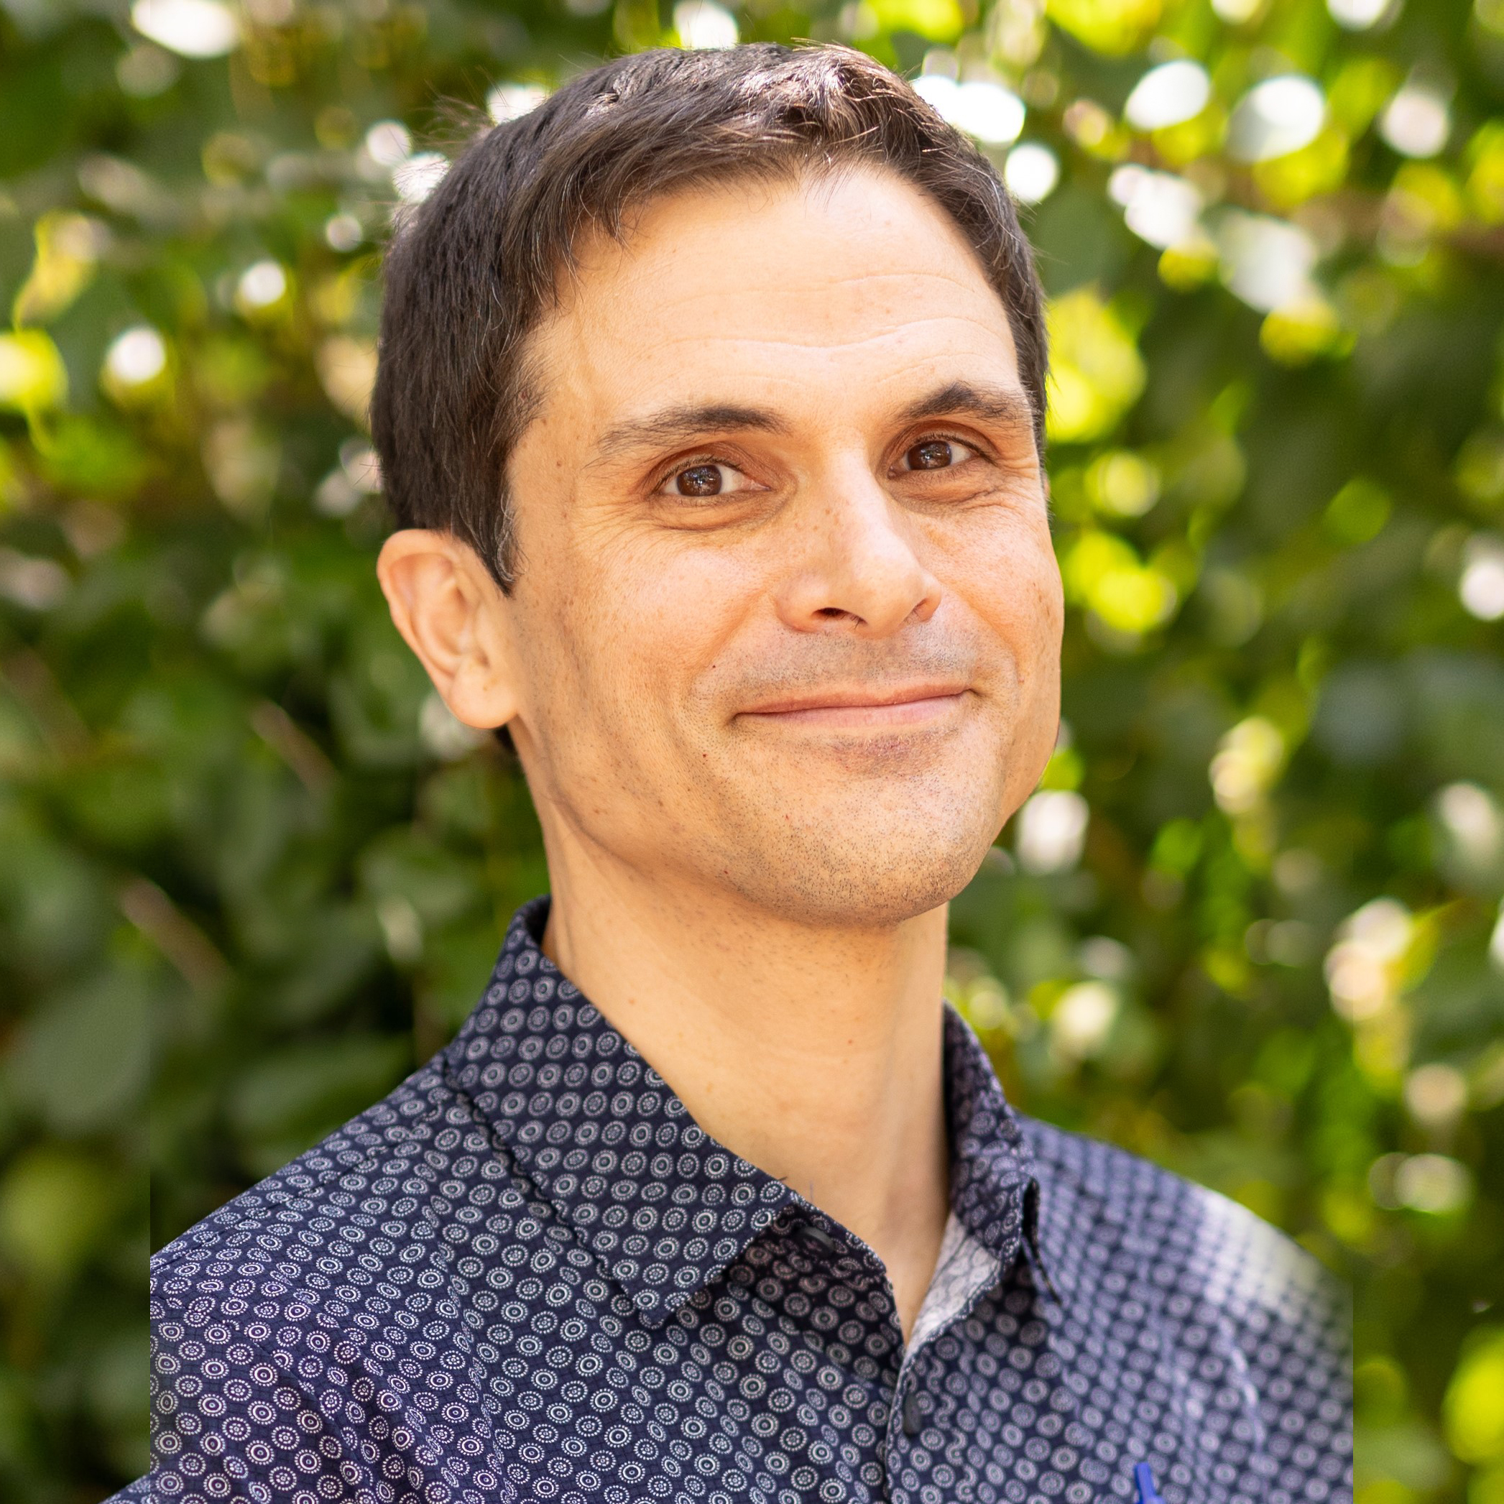
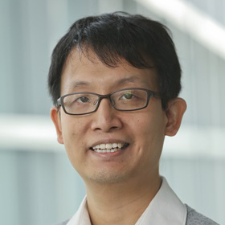
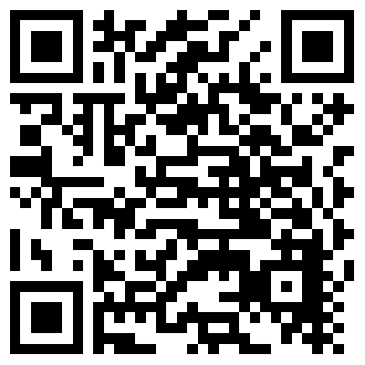
Interdisciplinary Research Seminar Series
Spring Semester 2025
11 March | 12:30 HKT
Dr. Annie Hongping Nie (The University of Hong Kong)
Rediscovering Ni Kwei Tseng and the Rise of the 'Soong Dynasty' in the Republican Era
25 March | 09:00 HKT
Professor Yuanchong Wang (University of Delaware)
God, Whale, and Steamship: Western Missionary Almanacs in Late Qing China
29 April | 09:00 HKT
Professor Micah Muscolino (University of California, San Diego)
Remaking the Earth, Exhausting the People: The Burden of Conservation in Modern China
20 May | 12:30 HKT
Professor Xing Hang (Hong Kong Polytechnic University)
The Mo Clan and Hà Tiên in the Chinese Century of Maritime East Asia, 1650-1800
Seminars usually take place on Tuesday in the lecture hall at May Hall or online
Sign up to our email list
Search for HKIHSS on

